Slide 1
DYRK1a, radiation and neural stem cells
Christie Palmer
15.07.2018

Slide 2
DYRk1A – a multifaceted kinase
Notes:
Maybe add structures of inhibitors + DYRK1a
parler des pro-oncogène et tumour suppressor: initially it’s a tumour supressor (since it’s anti proliferation!) but drives the tumour as it progresses (because of it’s pro-survival aspect) and is responsible for a lot resistance (goes into quiescence instead of apoptosis).
theory of DYRK1A, ensuite parler de radiation and challenges that could imply. mettre la différentiation, un des challenges? Avec le workflow? Ensemble, oui.
Alamarblue and
PArler de la simulation etc: un slide sur le bioreacteur avant et les 3 autres designs qui ont écoulé + shot (ANIME??) des simulations.
WHAT’S NEXT (last slide):
get proper moulds of the new model - where bioreactor and DYRK1A meet

Slide 3
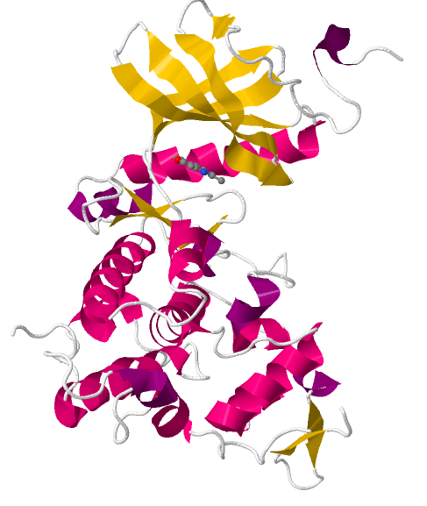
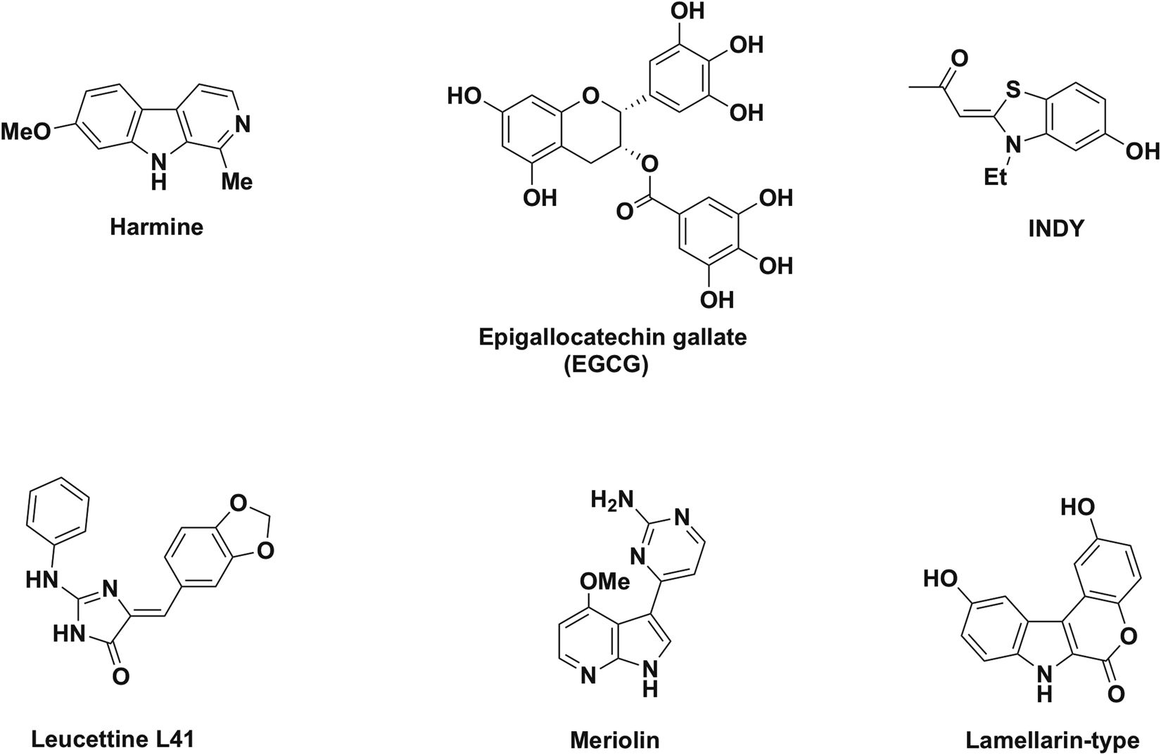
Dyrk1a and its inhibitors
DYRK1A/Harmine complex
Neuman et al. Nature 8:2859
RCSB
PDB 3ANR
Notes:
+ inhibitors
Dyrk1a very sensitive to oxygen levels + mechanical stress (better control in bioreactor) + LITERATURE
All ATP competitor but some have higher affinity than others and higher specificity.

Slide 4
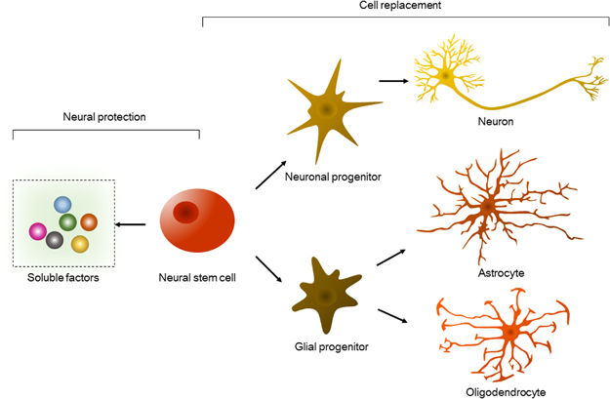
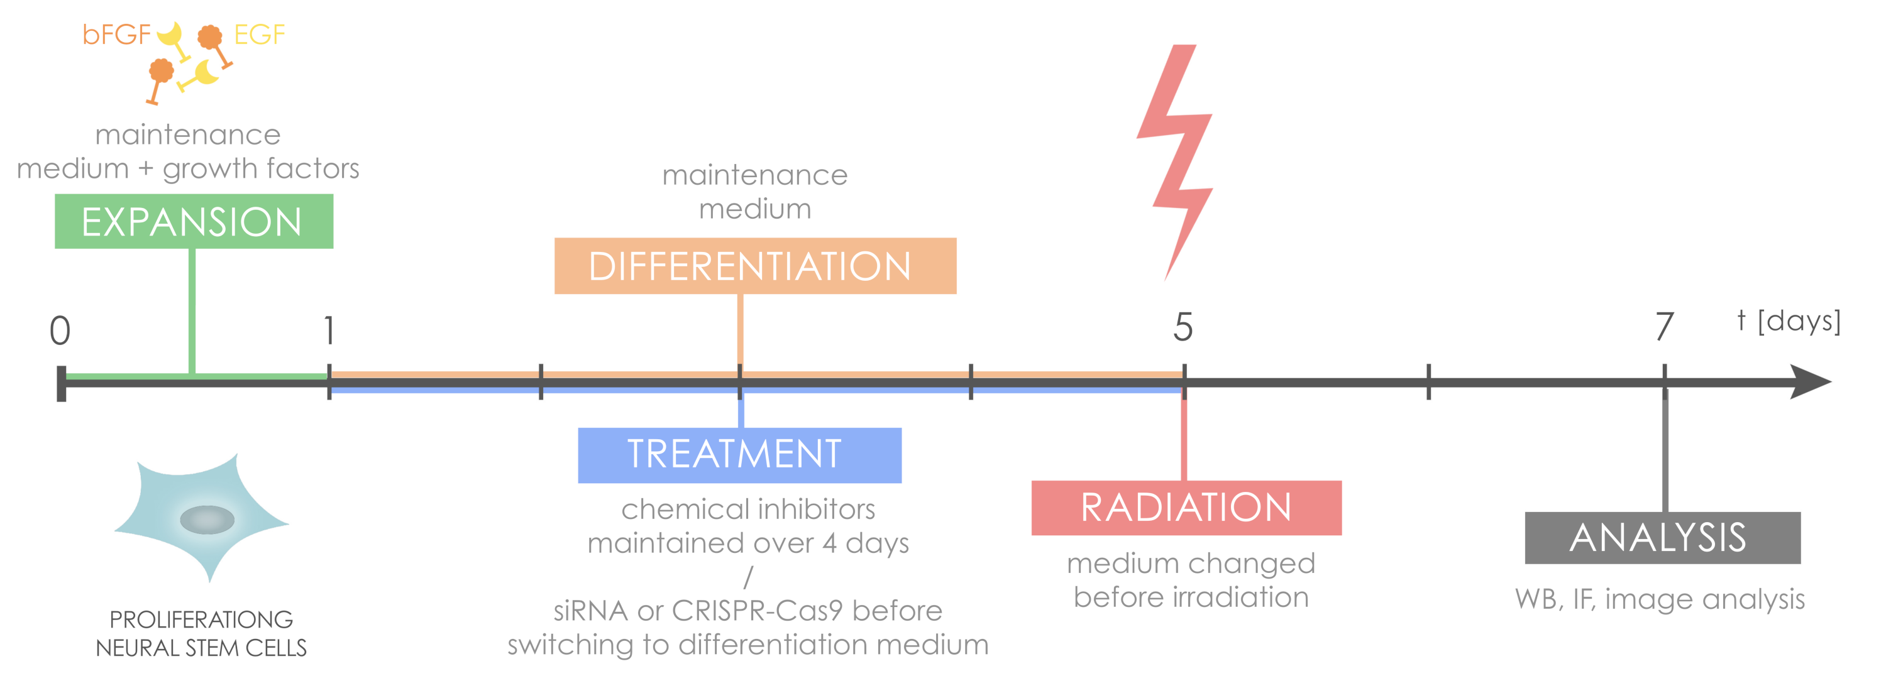
fate of Neural stem cells
RCSB
PDB 3ANR
Notes:
theory of DYRK1A, ensuite parler de radiation and challenges that could imply. mettre la différentiation, un des challenges? Avec le workflow? Ensemble, oui.

Slide 5
radiation, dyrk1a and stem cells
Notes:
Expliquer why it’s relevant et les challenges (chez kids, et chez Mars)
Would be cool to put an image of radiation ctrl vs no ctrl IF
Mention x-rays (against alpha particles) – clinical relevance
It’s interesting to see the effect of radiation on the stem cells which are maintained in adults: this is relevant for head and neck cancer patients which undergo radiotherapy, to see the effects on the pool of stem cells. This is why we’re using x-rays to radiate, to remain clinically relevant. Also interested for the NASA as cosmic rays are a big limitation to space travel – aquiring a little more knowledge on the effect of radiation!

Slide 6
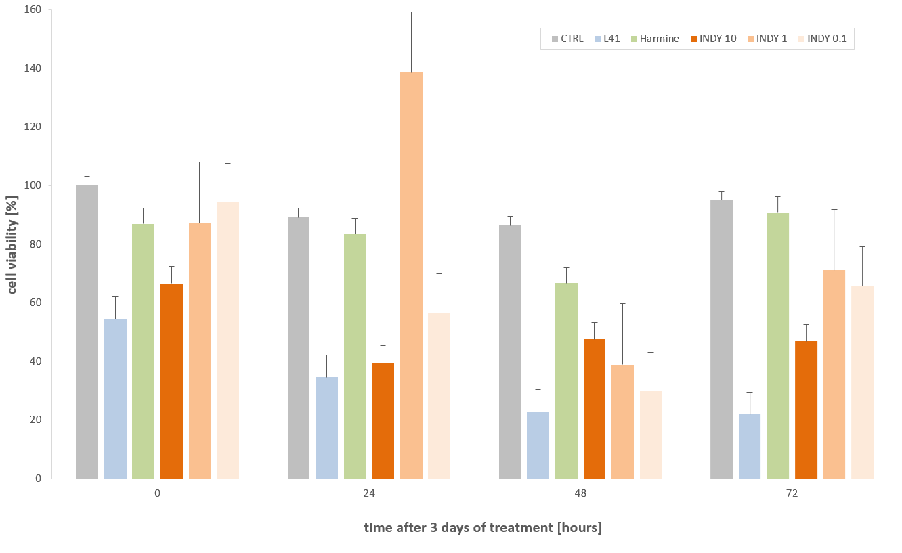
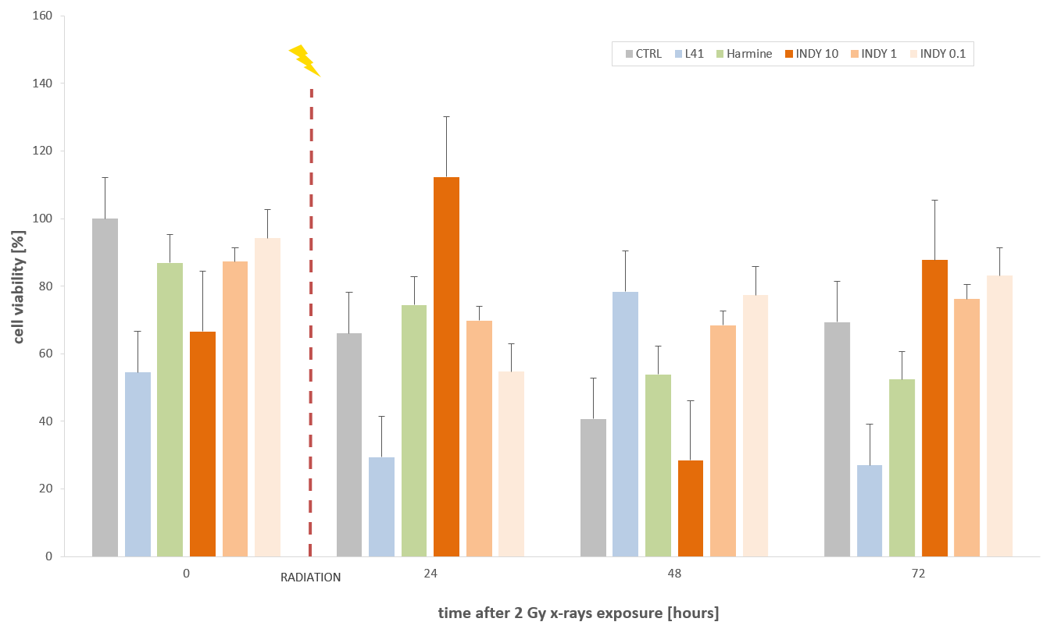
Toxicity and radioprotection
Do these drugs have a significant cytotoxicity on Ren VM cells? (initial tolerance assay)
If they are tolerated, do they act as radiosensitisers or a radioprotecters?
Notes:
Living cell analysis technique – looking at cell viability + oxidative stress (for DCF) – technical challenge – but optimise
L41 is interesting as well, if we change the dose (say to 1 or 0.1 instead of 3), might be protective!

Slide 7
RESULTS
- drug inhibition of DYRK1A with Harmine, Leucettine 41 (L41) and INDY.
transient knockout of DYRK1A with SiRNA
electroporation: transfection efficiency of 37%
lipofection: with Lipofectamine 2000 and RNAiMAX, both very low yield of efficiency (a few percents)
-
Notes:
Expliquer why it’s relevant et les challenges (chez kids, et chez Mars)
(2D get more detailed at 63x, subcellular details even if unusual in bioreactors, cytoskeleton shows up best in 2D)

Slide 8
siRNA transfection (OPTIMISATION)

Slide 9
DIFFErentiation and if STAINING (OPTIMISATION)

Slide 10
differentiation characterisation

Slide 11
differentiation and radiation
control
radiated

Slide 12
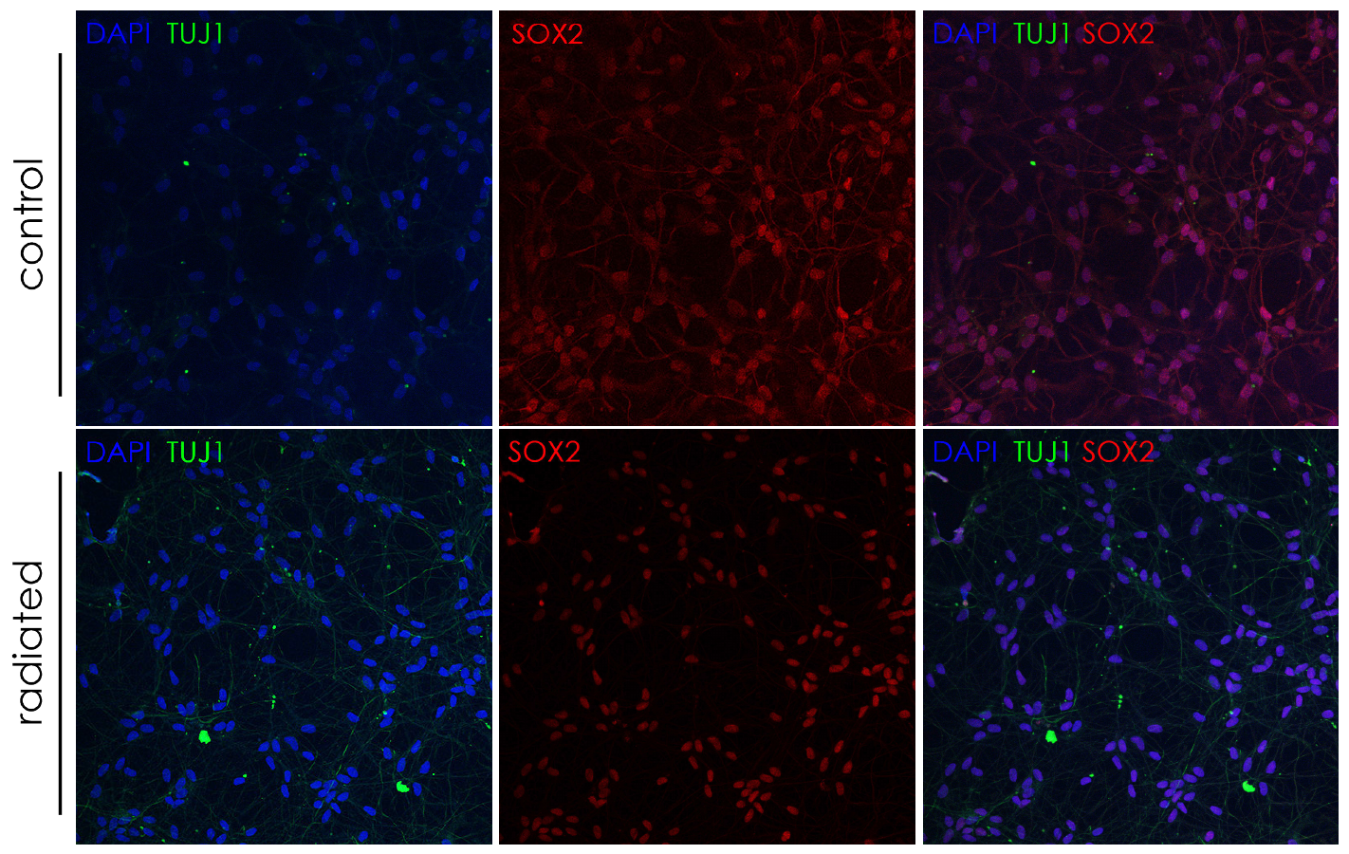
differentiation and radiation
Notes:
How to quantify? Tricky to count, it seems like it’s more a question of brightness… ?

Slide 13
prototypes of perfused bioreactors
1
4
3
2

Slide 14
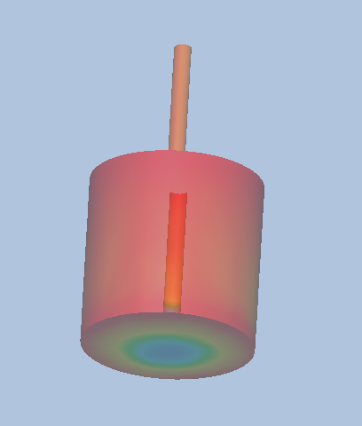
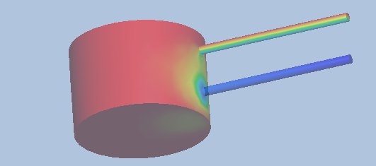
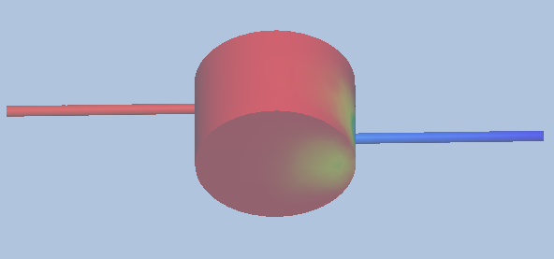
simulations of perfused bioreactors
Notes:
Limitations: the computational power, this was done on a regular (how many cores?) computer, so it’s hard to model such a process since it is so slow. Here, it’s been scaled up (so the dimensions remain the same, but the flow is higher and diffusion coefficient is different – must check). This is risky since it can make a big difference (using very high inlet velocity will lead to a completely different flow pattern), but hopefully it remains realistic in this case (still extremely slow flow).

Slide 15
conclusion and future work
Is the differentiation process kickstarted by radiation reversible or does it irrevocably exhaust the pool of NSC? → modify the principal experiment and re-introduce growth medium.
CRISPR: with a DYRK1A knock-out, inspect the repercussions on differentiation and apoptosis.
DCFDA assay to check for the protective effect with ROS
transfer experiments to SY5Y (neuroblastoma cell line)

Slide 16
AKNOWLEDGEMENTS
Thank you to Eric O’Neill, Xiao Wan, Luana Campos Suarez and Asmita for their precious help and guidance.

